Slide 1
GDP Group 18
Unmanned Aircraft Camera Module
Notes:
Michael Start
Welcome

Slide 2
The Next 20 Minutes
Recap
Specification and Progress Overview
Implementation
Testing
Demo
Evaluation
Future Work
Conclusion
Questions
Notes:
Michael
Describe our project: problem, specification, etc
How we’ve managed the project so far
Progress
Future plans

Slide 3
Recap
Notes:
Michael

Slide 4
Problem
Currently, an autopiloted UAV may take pictures while it is in the air
On many UAV systems the aircraft must land before images can be downloaded and viewed
These images could be inadequate
Wireless transmission of images preferred
Notes:
Michael

Slide 5
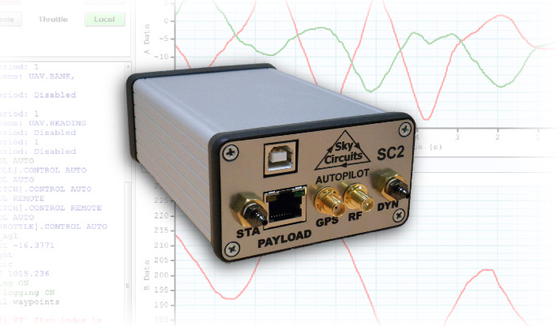
SkyCircuits Autopilot (SC2)
http://www.skycircuits.com/
Notes:
Michael

Slide 6
Specification & Progress Overview
Notes:
John

Slide 7
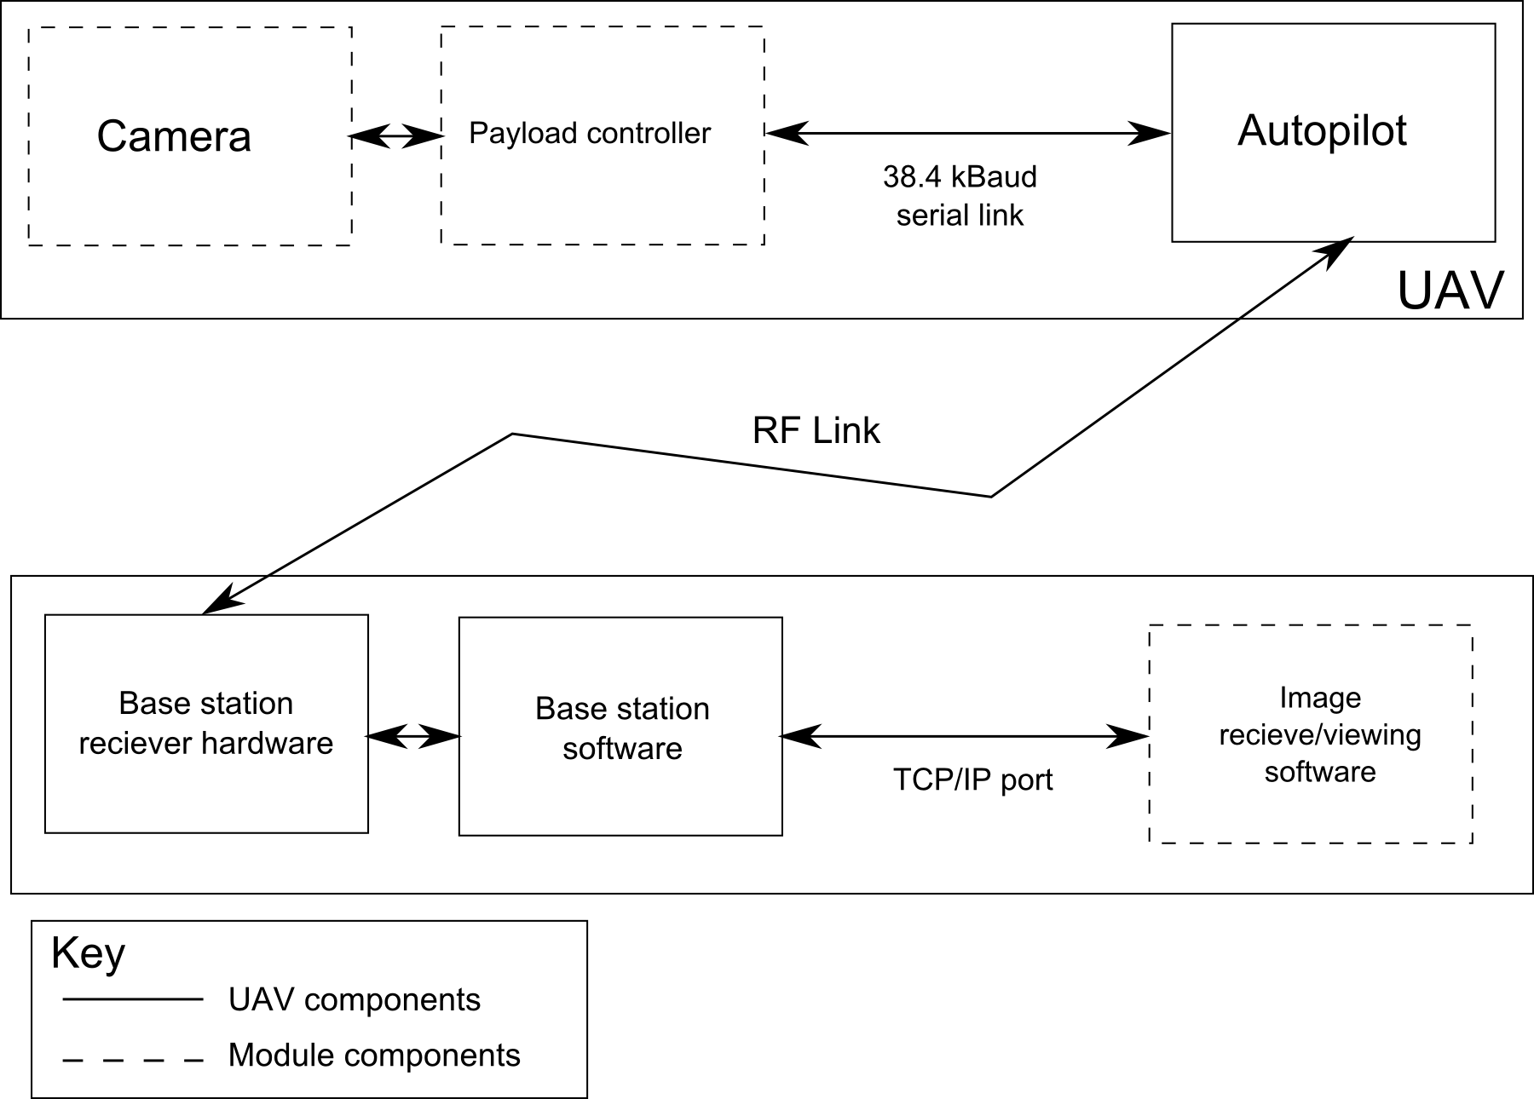
Block Diagram
Notes:
John“To design, build and test an electronic module capable of capturing still images from an unmanned aerial vehicle (UAV) and transmitting the images to a base station. The module must use the UAV autopilot’s low-bandwidth RS485 serial link (38.4 kBaud). A program must be written to interface with the base station software over a TCP/IP link, allowing image data to be received and displayed to the user. The electronic module will be constructed using strip-boards and will later be implemented on PCB if time is available.

Slide 8
Spec: High Priority
Prompt (from base station) to capture and download image
Progressive Image encoding/decoding
Minimise download time (less than 3 minutes)
Notes:
John

Slide 9

Spec: High Priority
Prompt (from base station) to capture and download image
GUI functional
Progressive Image encoding/decoding
Lowered in priority, some code written
Minimise download time (less than 3 minutes)
Approximately 8s capture + 12s download for 640x480
Notes:
John

Slide 10
Spec: Medium Priority
Module weight < 250g
Image resolution: 640 x 480
Cancel image download whilst downloading
Notes:
John

Slide 11
Spec: Medium Priority
Module weight < 250g
~70g
Image resolution: 640 x 480
Cancel image download whilst downloading
Notes:
John

Slide 12
Spec: Low Priority
Resend an image if corrupted
Interrupt download of image, save incomplete image
Select resolution of image
Display progress indicator of download
(User defined) Automatic image capture
Colour images
Select between colour / BW
Notes:
John

Slide 13
Spec: Low Priority
Resend an image if corrupted
Automatic Repeat reQuests (ARQ)
Interrupt download of image, save incomplete image
Select resolution of image
Display progress indicator of download
Notes:
John

Slide 14
Spec: Low Priority (cont.)
(User defined) Automatic image capture
Autopilot script triggers on waypoints, height, etc.
Colour images
Select between colour / BW

Slide 15
Spec: Deliverables
Hardware: Constructed camera module
Software: Firmware for module, Software for base station
Documentation: Technical and User Documentation
Public Repository: Open source, publically accessible repository, includes all the above
Notes:
John

Slide 16
Spec: Deliverables
Hardware: Constructed camera module
All on PCB
Software: Firmware for module, Software for base station
Documentation: Technical and User Documentation
Public Repository: Open source, publically accessible repository, includes all the above.
https://github.com/uavcamera/uavcamera
Notes:
John

Slide 17
Implementation

Slide 18
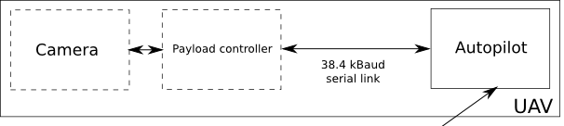
Ground Station -> Payload Communication
Autopilot -> Payload comms: Message sending
Autopilot
Message
Payload
Ground Station
Our GUI
Console Port

Slide 19
Ground Station <- Payload Communication
Payload -> Autopilot comms: Shared memory
Our GUI
Autopilot
Ground Station
Shared memory
Payload
Data Port

Slide 20
Commands
10 Commands
Uses Automatic Repeat reQuest (ARQ)
For image data acknowledgment sent every 50 data packets
E.g. Image Download Request:
0x02 0xXX 0xXX
Command ID
Image ID to Download (LSB)
Image ID to Download (MSB)

Slide 21
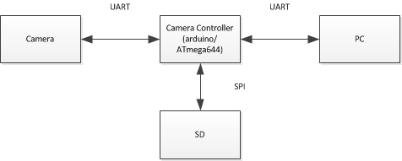
Camera Communication
JPEG images at:
80 x 64
168 x 128
320 x 240
640 x 480
SD card used as storage
Autopilot

Slide 22
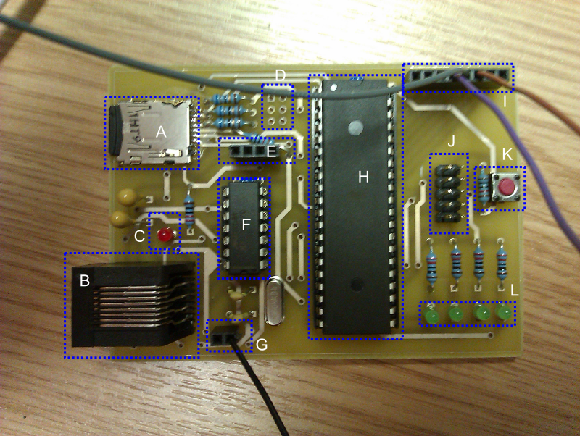
Physical Implementation

Slide 23
Tools Used
C# .NET for GUI (Visual Studio 2010)
C++ (including Sanguino libraries) Eclipse
MATLAB for progressive image testing
gEDA for schematics/PCB layouts
Git for version control

Slide 24
Cost to Reproduce
 | Through Hole | Surface Mount
PCB (15 day, PCBtrain, ex. Delivery) | £33.08 | £33.08
Components (Farnell, inc. VAT, delivery) | £22.63 | £25.84
Camera (inc. VAT, ex. Delivery) | £52.80 | £52.80
TOTAL | £108.51 | £111.72

Slide 25
Testing

Slide 26
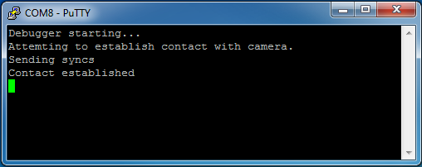
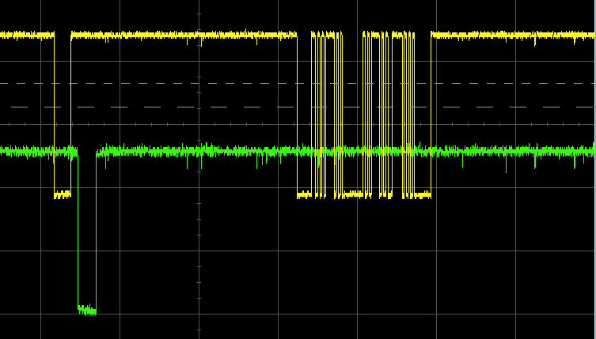
Debugging
Implemented simple debug interface for payload over SPI
Testing central to debugging implementation

Slide 27
Test Plan
Iterative testing during implementation
Design
Test
Prototype

Slide 28
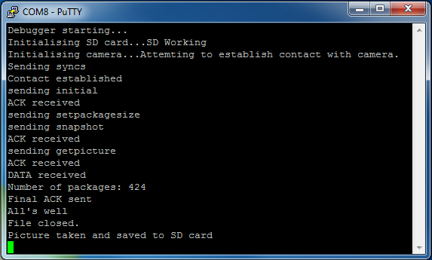
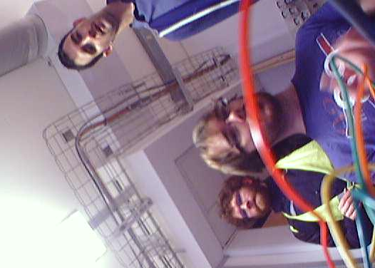
Camera Testing
Establishing Contact
Getting Image

Slide 29
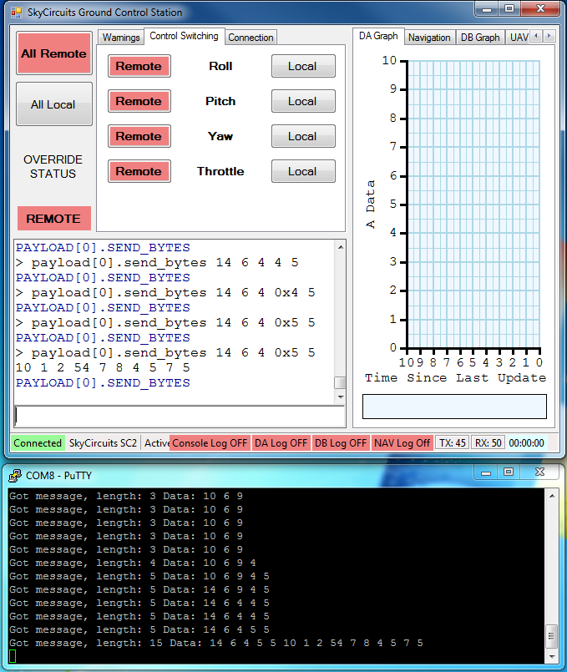
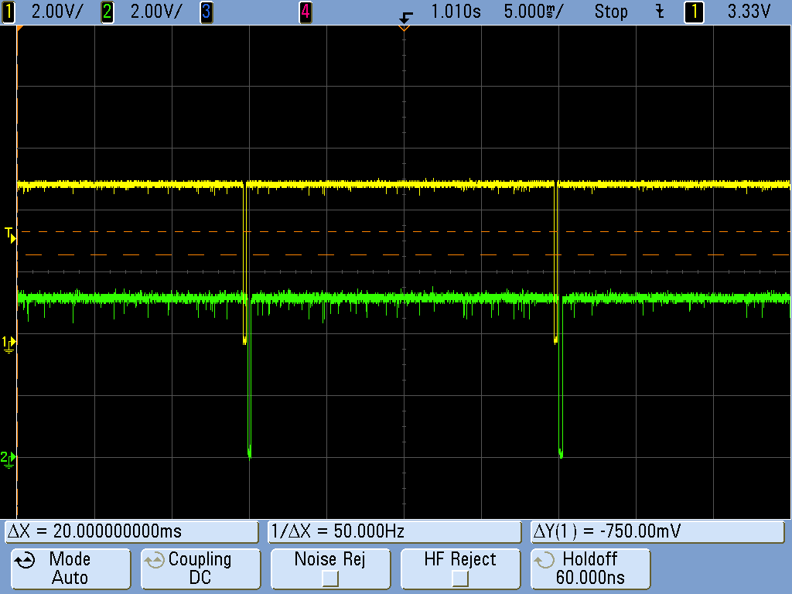
Payload to Autopilot Communications Testing
Basic Connection
(Tx Tokens)
Setting Shared memory
and Sending Messages
Image Sending
Over Autopilot Link
Reliable Transmission using ARQs

Slide 30
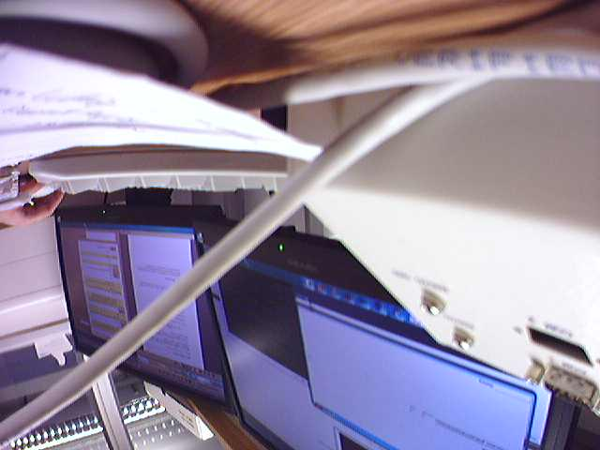
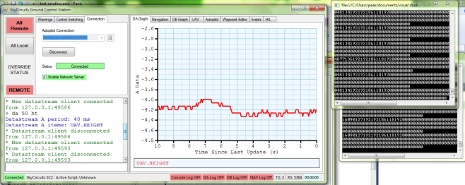
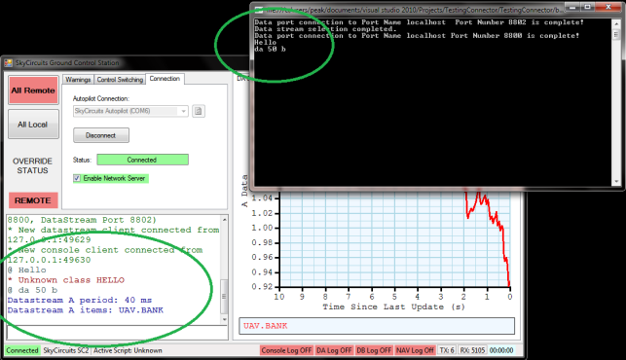
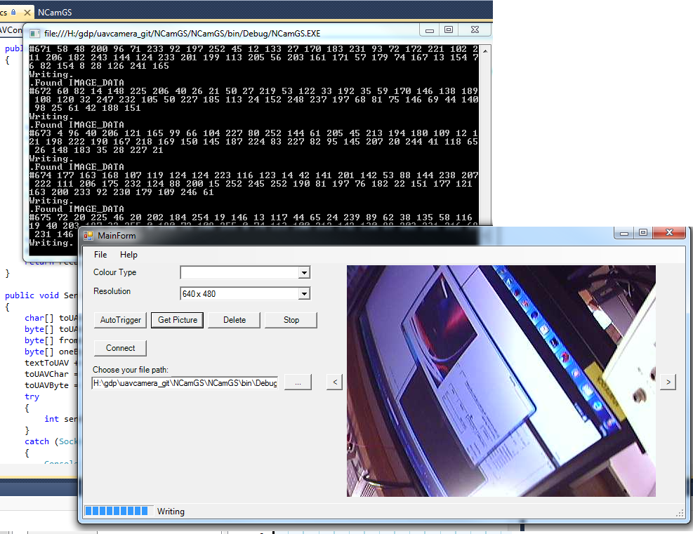
Ground Station Software Testing
Streaming Data from
SkyCircuits Software
Basic Image Download via Autopilot Link
Sending Command to
SkyCircuits Console Port
Image Capture and Download Using GUI

Slide 31
ARQ Testing
Packet loss simulated
1 in 100 probability of packet dropping.
Software resent commands and image data that were not acknowledged.

Slide 32
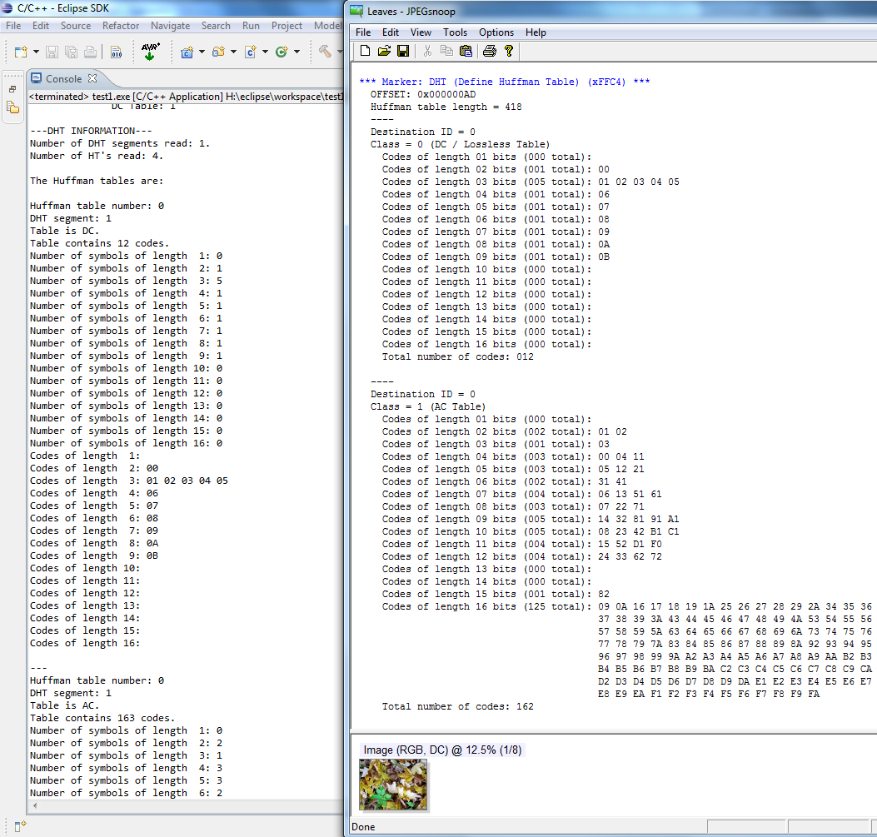
JPEG Header Extractor Testing
DCT and Huffman tables extracted
Extraction results compared with open source model (JPEGsnoop)
Tested against a variety of 640x480 images

Slide 33
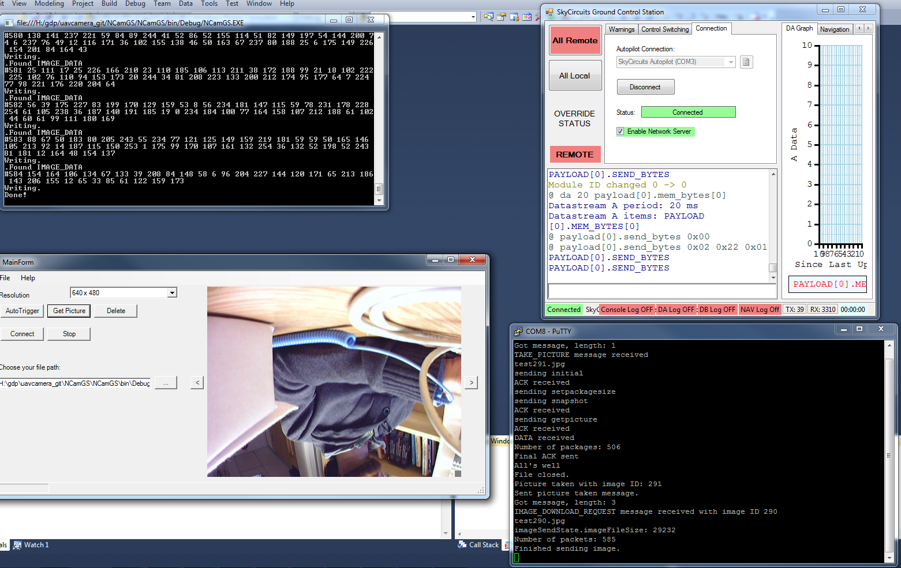
Final Testing

Slide 34
Final Testing
Speed (at 640x480) – No Dropped Packets:
~8s Capture
~12s Download
~20s Total
Weight:
~53g Without camera case
~70g With camera case

Slide 35
Demo

Slide 36
Evaluation

Slide 37
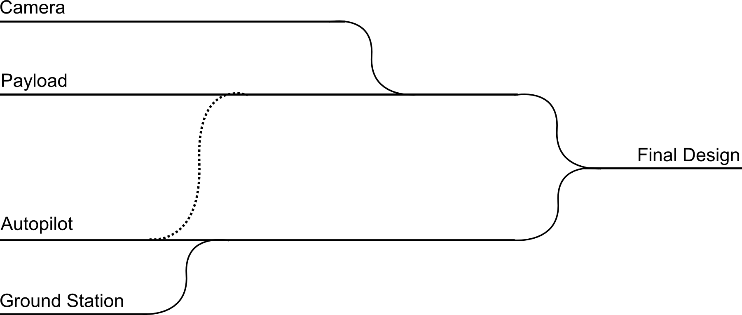
Streams
Acquired working camera
Got image off camera
Payload communicating with camera
Payload communicating with autopilot
Working GUI
Our software communicating with Autopilot via GS software
Autopilot debugging
PCB Implementation

Slide 38
Management
Regular group meetings and progress reviews
Helped identify problems early
Minutes for when we needed to refer back to them
Good Communication
Email, telephone, IRC, meetings, source control

Slide 39
Obstacles
Two camera failures
Ordered new cameras, modified project plan to fit around first delay, postponed flight test due to second.
Bug in Autopilot code
Extensive debugging alongside supplier of autopilot.

Slide 40
Future Work
Progressive Image Transfer
Multiple cameras at once (possibly 3D)
Multiple types of camera
Video Streaming
SD file system access
HDR Photography
Image processing (e.g. for target fixation)

Slide 41
Conclusion

Slide 42
Conclusion
As previously mentioned, most of specification was completed on time, under budget.
Elements that weren’t completed, there’s a good reason for. Mostly low-priority tasks.
We have delivered a working system to our customer. ##FINGERS CROSSED FOR TOMORROW##

Slide 43
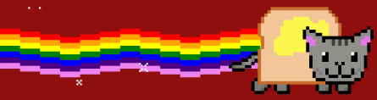
Questions?

